Slide 1
Operating Systems
Chapter 7 (a)
Deadlocks
Hammad Afzal
hammad.afzal@mcs.edu.pk
Department of Computer Software Engineering
National University of Sciences and Technology

Slide 2
Chapter 7: Deadlocks
The Deadlock Problem
System Model
Deadlock Characterization
Methods for Handling Deadlocks
Deadlock Prevention

Slide 3
Chapter Objectives
To develop a description of deadlocks, which prevent sets of concurrent processes from completing their tasks
To present a number of different methods for preventing or avoiding deadlocks in a computer system

Slide 4
System Model
Resource types R₁, R₂, . . ., R_{m}
CPU cycles, memory space, I/O devices
Each resource type R_{i} has W_{i} instances.
Each process utilizes a resource as follows:
Request:
Request can be granted immediately or process has to wait if resource is being used by other process
Use
Process can operate a resource
Release
Process releases the resource

Slide 5
System Model
Request and release are system calls
Examples: request() device, open(), close();
For kernel resources, system table records whether each resource is free or allocated.
For each allocated resource, table also records the process to which resource is allocated.
If a process requests a resource that is currently allocated to another process, it can be added to a queue of processes waiting for this instance.

Slide 6
The Deadlock Problem
A set of blocked processes each holding a resource and waiting to acquire a resource held by another process in the set
Example
System has 2 disk drives
P₁ and P₂ each hold one disk drive and each needs another one

Slide 7

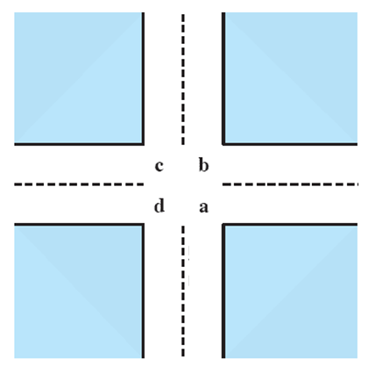
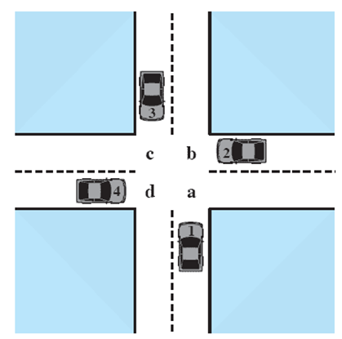



Potential Deadlock
I need quad C and D
I need quad B and C
I need quad A and B
I need quad D and A
Notes:
Animated Slide
Click 1 Cars approach intersection
Then Cars announce their resource needs
All deadlocks involve conflicting needs for resources by two or more processes. A common example is the traffic deadlock.
The typical rule of the road in the United States is that a car at a four-way stop should defer to a car immediately to its right.
This rule works if there are only two or three cars at the intersection.
If all four cars arrive at about the same time, each will refrain from entering the intersection, this causes a potential deadlock.
The deadlock is only potential, not actual, because the necessary resources are available for any of the cars to proceed.
If one car eventually does proceed, it can do so.

Slide 8
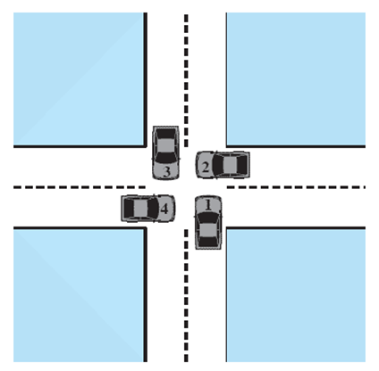
Actual Deadlock
HALT until D is free
HALT until C is free
HALT until B is free
HALT until A is free
Notes:
Animated Slide
Click 1 Cars move to deadlock
Then Cars announce their resource need
But if all four cars ignore the rules and proceed (cautiously) into the intersection at the same time, then each car seizes one resource (one quadrant) but cannot proceed because the required second resource has already been seized by another car.
This is an actual deadlock.

Slide 9
Bridge Crossing Example
Traffic only in one direction
Each section of a bridge can be viewed as a resource
If a deadlock occurs, it can be resolved if one car backs up (preempt resources and rollback)
Several cars may have to be backed up if a deadlock occurs
Starvation is possible

Slide 10
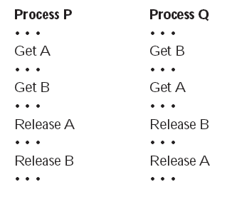
Two Processes P and Q
Lets look at this with two processes P and Q
Each needing exclusive access to a resource A and B for a period of time
Notes:
Each process needs exclusive use of both resources for a certain period of time.
Two processes, P and Q, have the following general form:

Slide 11
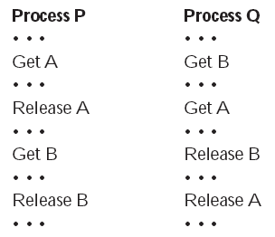
Alternative logic
Suppose that P does not need both resources at the same time so that the two processes have this form
Notes:
Whether or not deadlock occurs depends on both the dynamics of the execution and on the details of the application.

Slide 12
Deadlock Characterization
Deadlock can arise if four conditions hold simultaneously.
Mutual exclusion:
At least one resource must be held in non-sharable mode - only one process at a time can use a resource
Hold and wait:
A process holding at least one resource and is waiting to acquire additional resources held by other processes

Slide 13
Deadlock Characterization
Deadlock can arise if four conditions hold simultaneously.
No preemption:
A resource can be released only voluntarily by the process holding it, after that process has completed its task
Circular wait:
there exists a set {P₀, P₁, …, P_{n}} of waiting processes such that P₀ is waiting for a resource that is held by P₁, P₁ is waiting for a resource that is held by P₂, …, P_{n–1} is waiting for a resource that is held by P_{n}, and P_{n} is waiting for a resource that is held by P₀.

Slide 14
Resource-Allocation Graph
A set of vertices V and a set of edges E.
V is partitioned into two types:
P = {P₁, P₂, …, P_{n}}, the set consisting of all the processes in the system
R = {R₁, R₂, …, R_{m}}, the set consisting of all resource types in the system
request edge – directed edge P_{i} → R_{j}
assignment edge – directed edge R_{j} → P_{i}

Slide 15
Resource-Allocation Graph (Cont.)
Process Resource Type with 4 instances
P_{i} requests instance of R_{j}
P_{i} is holding an instance of R_{j}
P_{i}
R_{j}
P_{i}
R_{j}

Slide 16
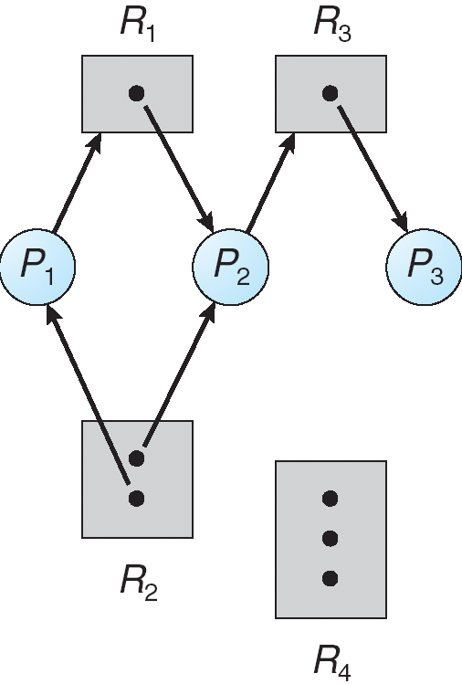
Example of a Resource Allocation Graph
P={P_{1,} P_{2,} P_{3,}}
R={R_{1,} R_{2,} R_{3,} R_{4,}}
E={P1→ R1,P2→R3, R1→ P2, R2→ P2, R2→ P1, R3→P3 }

Slide 17
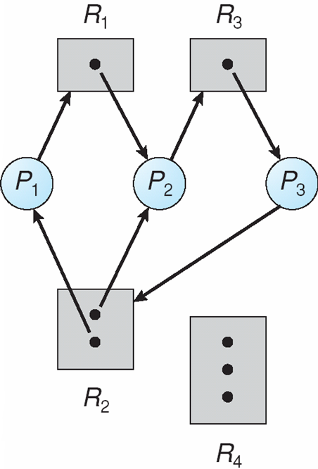
Resource Allocation Graph With A Deadlock
If the graph contains cycle, then a deadlock may exist.
If resources in cycle have single instance, then deadlock exists.
Each process involved in cycle are deadlocked.
Notes:
http://cs.uttyler.edu/Faculty/Rainwater/COSC3355/Animations/deadlock.htm

Slide 18
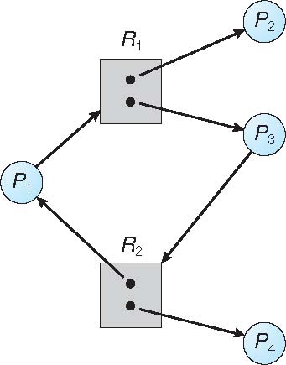
Graph With A Cycle But No Deadlock
If resources have multiple instances, then deadlock doesn’t necessarily exist.
Cycle is necessary but not sufficient condition for deadlock.

Slide 19
Basic Conditions for deadlock
If graph contains no cycles ⇒ no deadlock
If graph contains a cycle ⇒
if only one instance per resource type, then deadlock
if several instances per resource type, possibility of deadlock

Slide 20
Dealing with Deadlock
Three general approaches exist for dealing with deadlock.
Prevent deadlock
Avoid deadlock
Detect Deadlock
Notes:
Three general approaches exist for dealing with deadlock.
prevent deadlock
adopt a policy that eliminates one of the conditions (conditions 1 through 4).
avoid deadlock
by making the appropriate dynamic choices based on the current state of resource allocation.
detect the presence of deadlock
(conditions 1 through 4 hold) and take action to recover.
We discuss each of these approaches in turn.

Slide 21
Dealing with Deadlocks
Three ways
Use a protocol to prevent or avoid deadlocks, ensuring that the system will never enter a deadlock state
Allow the system to enter a deadlock state and then recover
Ignore the problem and pretend that deadlocks never occur in the system; used by most operating systems, including UNIX.
Deadlock prevention provides a set of methods for ensuring that at least one of the necessary conditions doesn’t occur.
Constraint on how request for resources are made
Deadlock avoidance requires that the OS be given in advance additional information concerning which resources a process will request.

Slide 22
Deadlock Prevention
Restrain the ways request can be made
Mutual Exclusion –
Must be supported by the OS
Must hold for non-sharable resources. E.g. printer
Not required for sharable resources; these resources cannot be involved in deadlock.
E.g. read only files
A process never needs to wait for sharable resource.

Slide 23
Deadlock Prevention
Restrain the ways request can be made
Hold and Wait –
Must guarantee that whenever a process requests a resource, it does not hold any other resources
Require process to request and be allocated all its resources before it begins execution,
or allow process to request resources only when the process has none
Low resource utilization;
Example from Book. (File from DVD, to file, sort and print)
Starvation possible (if process needs lots of popular resources)

Slide 24
Deadlock Prevention (Cont.)
No Preemption –
If a process that is holding some resources requests another resource that cannot be immediately allocated to it, then all resources currently being held are released
Preempted resources are added to the list of resources for which the process is waiting
Process will be restarted only when it can regain its old resources, as well as the new ones that it is requesting

Slide 25
Deadlock Prevention (Cont.)
Circular Wait
Impose a total ordering of all resource types, and require that each process requests resources in an increasing order of enumeration.
Example from Book

